Slide 1
Unconscious Bias
Conference of Colleges Diversity Fund Project on special dietary requirements of BAME and observant religious students
The Listening Brain, Source: The Wellcome Institute

Slide 2
Feeding the world in the uk
Module 4

Slide 3
Your Name Here
Your College Here

Slide 4
INTRODUCTIONS
Your name and what you do
How long you have done it?
Why are you here?
Why do you want to be a trainer on this subject?
Notes:
4

Slide 5
Domestics
Respectful use of phones please
Emergency evacuation
Toilets
Refreshments

Slide 7
Ice breaker
Quick round of alphabet ingredients
Notes:
(trainer facilitates this quickly starting with A and moving round the group)

Slide 8
Worldwide Eating and setting the context
Module 4

Slide 9
Thinking Space 1
Why is it important we consider world food in our menu planning?

Slide 10
Thinking Space 2
What is the potential impact on the student when we don’t consider globally diverse food?

Slide 11
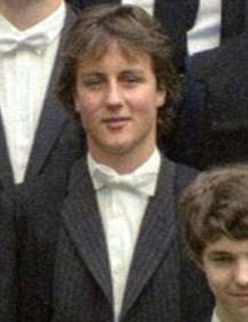
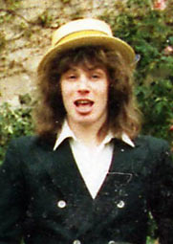
Who is the Oxford Student?
In 2017 there were approximately 23,000 Students
This is the traditional view of an Oxford Man, or indeed Woman
Notes:
Tony Blair went to St John’s College – reading Jurisprudence
David Cameron went to Brasenose College – reading Philosophy, Politics and Economics
Theresa May went to St Hughes College – reading Geography
Boris Johnson went to Balliol College – reading Literae Humaniores (Classics)

Slide 12
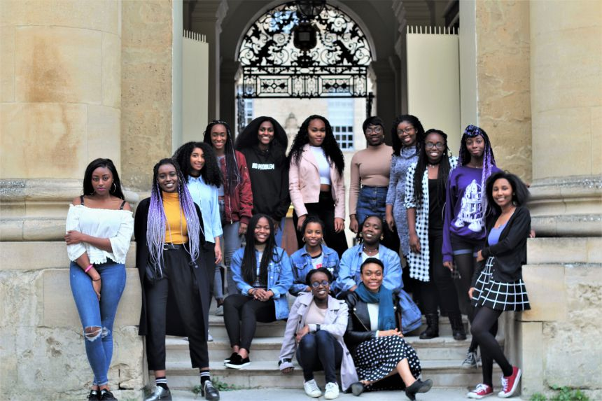
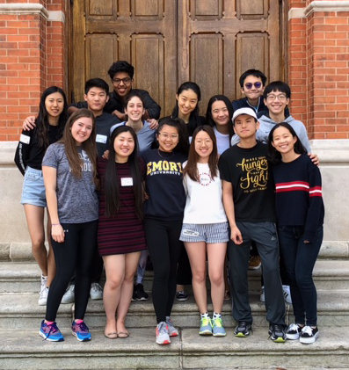
Things are changing
In 2017 10,400 of student body were international students
From 138 countries

Slide 13
Paying Customers
Many International Students will pay directly for their education
Students at Oxford are by definition very smart
The University is part of a global marketplace
Do you think the College menus should reflect this diversity?

Slide 14
138 Countries
Afghanistan
Algeria
Bahamas
Benin
Bhutan
Burkina Faso
Congo
East Timor
Ethiopia
Gambia
Laos
Mali
Mozambique
St Lucia
Togo
Uruguay
Yemen
in 2017 there were 16 students
They were the only people from their country
Here at Oxford
Lonely, or what!
How do you comfort eat in a strange land?
Notes:
Each of the countries on the right had a single student here at Oxford

Slide 15
Fitting in
Some students cannot eat the wonderful food you produce:
For cultural reasons
For religious reasons
For biological reasons
Because they miss home
When the Brits go abroad we famously take our food with us
What do your students bring here?

Slide 16
Name that food
University of Oxford

Slide 17
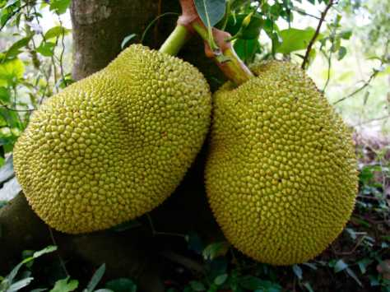
Name that Food

Slide 18
Name that Food - Jackfruit
Grown in an area between southern India and Borneo
Used in cuisine of South and South East Asia
Can be used in pastries and deserts
A popular alternative to meat in savoury dishes
Has the consistency of Pulled Pork
Notes:
Originally called Jaca by the Portuguese who were the first Europeans to see it and who couldn’t pronounce the Malayam term Chakka.

Slide 19
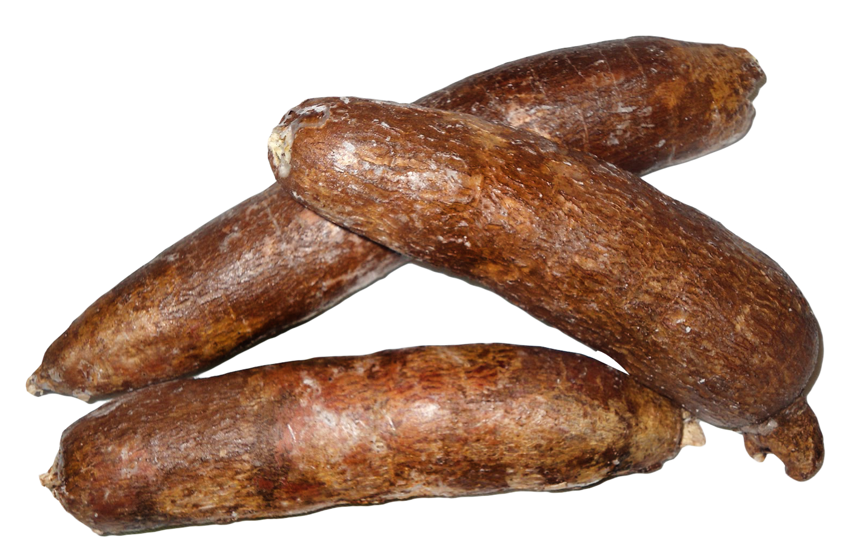
Name that Food

Slide 20
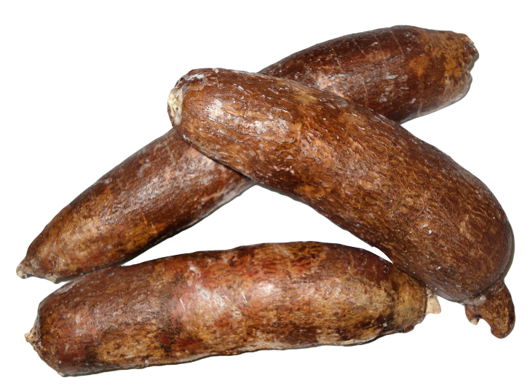
Name that Food - Cassava
Grown in tropical and sub-tropical areas worldwide
A major staple in West Africa
Root used for breads, chips, flakes, flour soups, stews

Slide 21
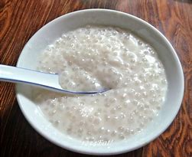
Better known to the British as
Tapioca Pudding
Made from the dried root

Slide 22
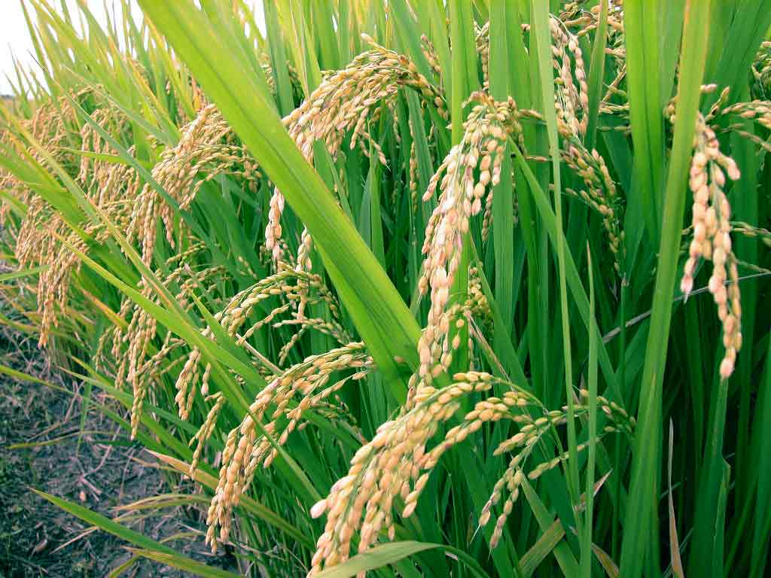
Name that Food

Slide 23
Name that Food - Rice
2/3 grown in Asia.
Staple food of over half the world's population.
Rice provides 20% of the world's dietary energy supply
It is used in many savoury and sweet dishes in cuisines around the world
Rice Pudding and a blob of jam was another school dinner staple!

Slide 24
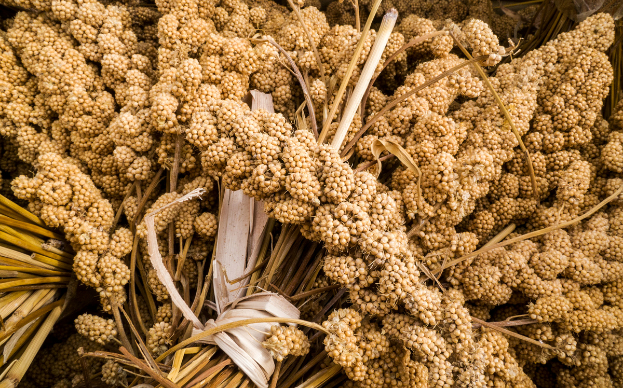
Name that Food

Slide 25
Name that Food - Millet
Millet is a small-seeded grass
An important crop in the Asia and Africa
97% of millet production in developing countries
Used as breakfast porridge
Replaces rice in the cuisine where it’s cultivated
In the developed world often used for animal fodder
In Britain we give it to our Budgerigars
Notes:
Millets may have been consumed by humans for about 7,000 years and potentially had "a pivotal role in the rise of multi-crop agriculture and settled farming societies“

Slide 26
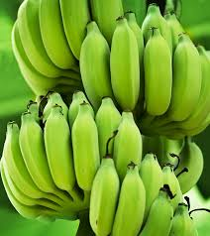
Name that Food

Slide 27
Name that Food – Green Plaintain
Grown in India Africa and the tropical parts of the Americas
Mainly eaten in:
West and Central Africa
Caribbean islands
Central America
Northern South America
Treated similarly to potatoes. They can be fried, boiled or made into soup
Green plantains are firm and starchy, and resemble potatoes in flavour

Slide 28
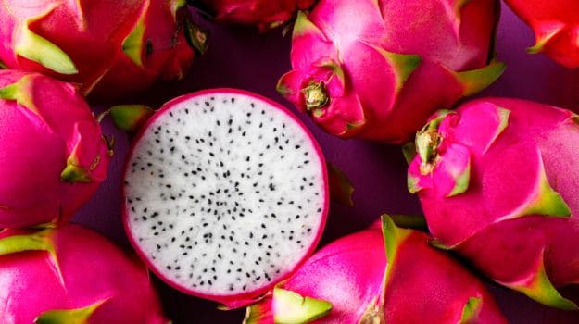
Name that Food

Slide 29
Name that Food - Pitaya
In the UK it’s known as Dragon fruit
Cultivated in South East Asia and the Caribbean
Mainly eaten as a fruit and can be used to make juice
Also an alcoholic drink called:
Dragon’s Blood Punch

Slide 30
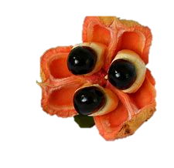
Name that Food

Slide 31
Name that Food - Ackee
Native to Africa and Imported to Jamaica in 1773
Now the national fruit of Jamaica with
Ackee and Saltfish being its national dish.
In West Africa Ackee is eaten raw, fried in oil, or mixed in soups
Related to the Lychee fruit it has a delicate, slightly nutty flavour

Slide 32
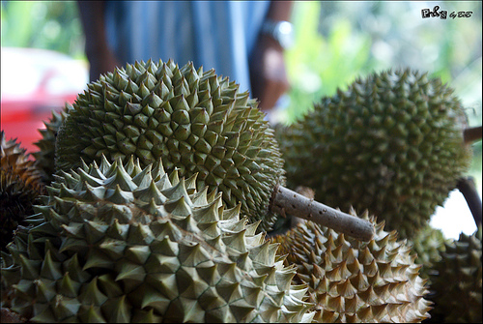
Name that Food

Slide 33
Name that Food - Durian
Grows in tropical regions
Popular in Southeast Asia
It is high in nutrients but has a bad reputation because of it’s disgusting smell
Used in sweet and savoury dishes
Described as tasting like cheese, almonds and caramel all at once.

Slide 34
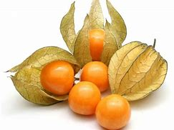
Name that Food

Slide 35
Name that Food – Physalis
Grown in warm temperate and subtropical areas
Has a small shiny yellow fruit with a strong citrus flavour
Can be eaten raw or poached
Can be used decoratively in cooking
Also known as the Cape Gooseberry

Slide 36
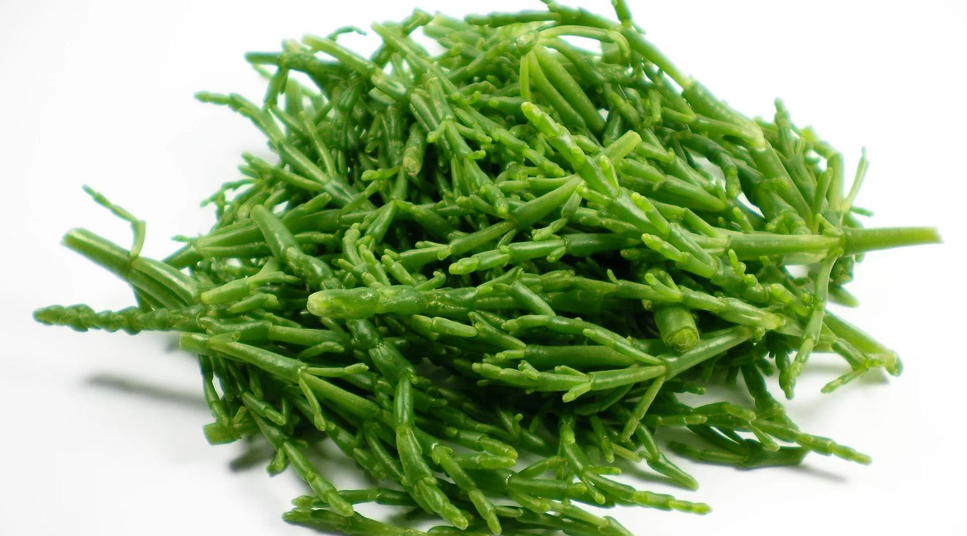
Name that Food

Slide 37
Name that Food - Samphire
A succulent that grows in rocky and marshy areas near to saltwater
Often an accompaniment to fish
Traditional Turkish cooks steam it with olive oil and garlic
In Norfolk, it’s traditionally served with vinegar and black pepper

Slide 38
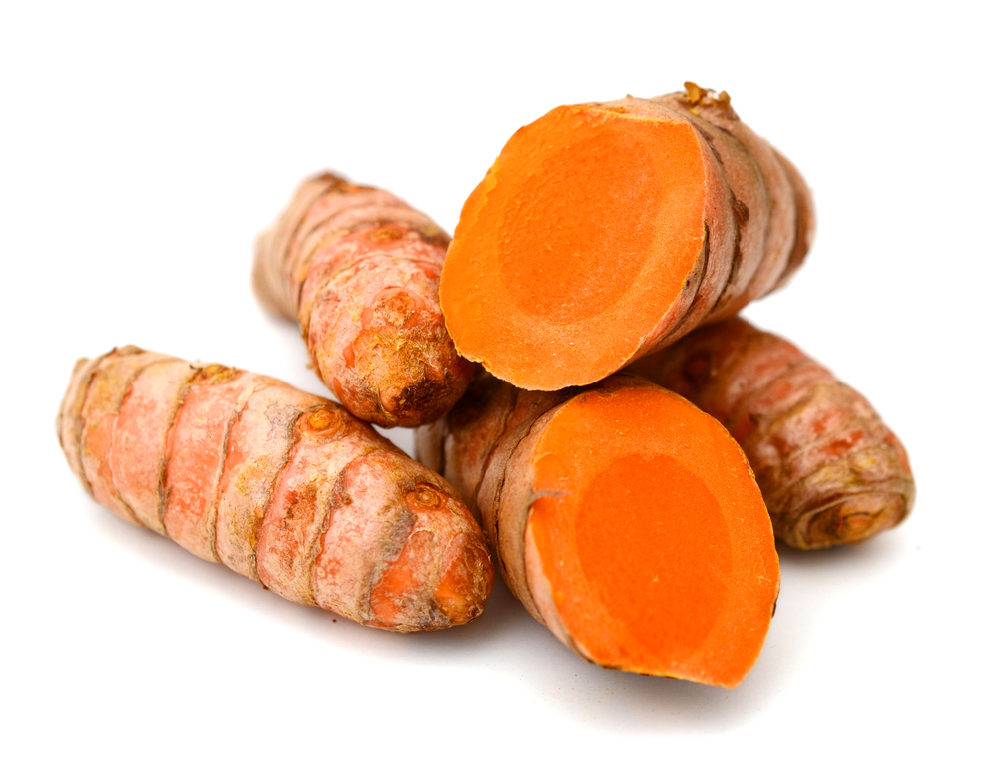
Name that Food

Slide 39
Name that Food - Turmeric
This year’s superfood!
From India and SE Asia
An ingredient in many savoury Asian dishes but:
Used in some desserts, and
To flavour warm, sweet milk
It gives off a mustard-like, earthy aroma
Used to treat arthritis in Chinese and Indian traditional systems of medicine

Slide 40
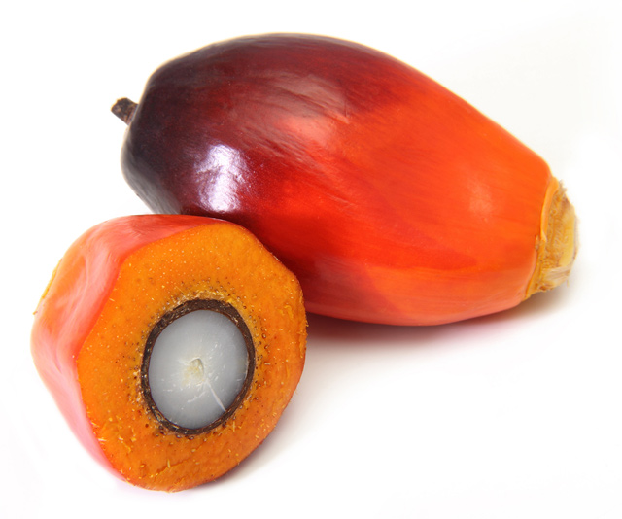
Name that Food

Slide 41
Name that Food – Palm oil
For every Super food there’s a Super villain!
It’s native to Africa.
Now grown in tropical areas of the world
Has a very bad environmental reputation
Palm Oil Plantations replacing Rain Forests
It is a naturally occurring saturated fat
Globally we are each eating about 7.7kg (17lbs) a year

Slide 42
What is it?
Call out what you think it is and what it’s used for

Slide 43
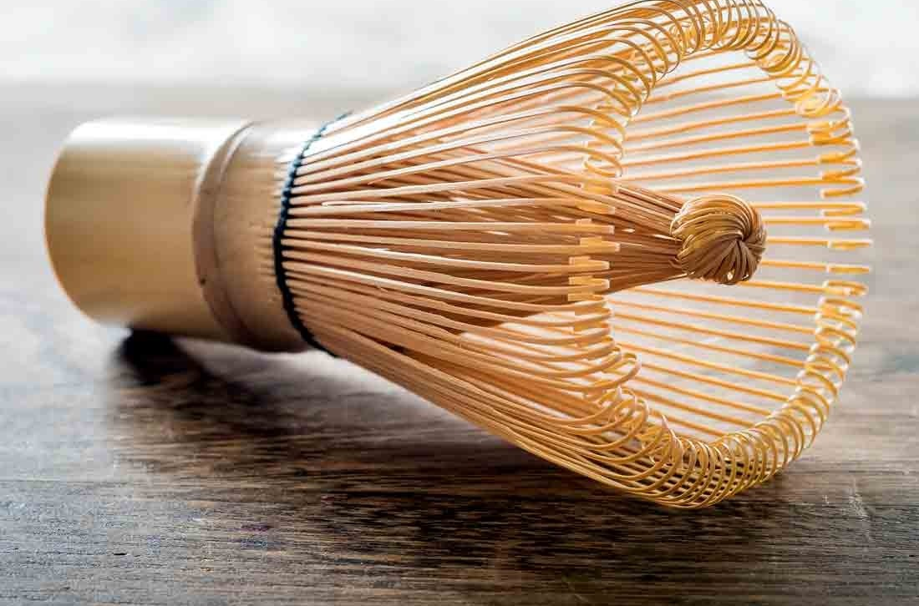
What is this used for?
Chasen Whisk
Notes:
Chasen Whisk - (or bamboo matcha whisk) is an integral part of the Japanese tea ceremony. It is used to make the powdered green tea called Matcha in a bowl. These days, many types of Chasen can be found in various colours and thickness. The whisk can be used as any whisk but great for frothing up milk!

Slide 44
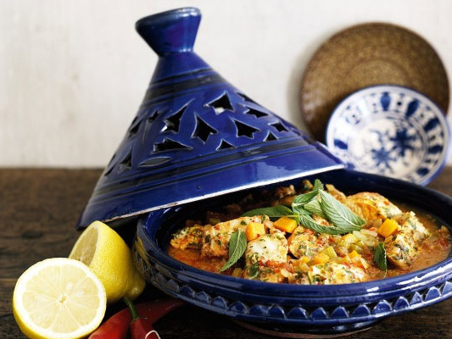
What is this used for?
Tagine
Notes:
Tagine - A tagine is a conical earthenware pot and the dish prepared in the tagine pot shares the same name as it's cooking vessel. So tagine is a dish and also a cooking pot. Historically, the nomads in North Africa used the tagine pot as a “portable oven”, allowing them to prepare food at anytime while moving around. The food is served in the dish and traditionally everyone eats from the tagine at the same time. It’s a very sociable and for some intimate way of eating.

Slide 45
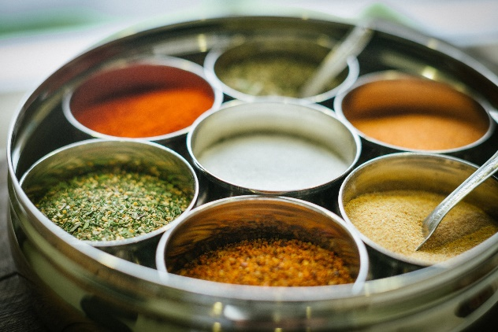
What is this used for?
Masala Dabba
Notes:
Masala Dabba – traditionally used in sub Indian households for the everyday spices used in curries and Indian dishes. Every Sub Indian will have one and will contain the main base spices for a curry like turmeric, chilli powder, cumin/coriander powder, salt, cumin seeds, mustard seeds and garam masala.

Slide 46
Eating Habits of people in the UK
Notes:
What do you see as traditionally British foods?
What influences what we eat here in the UK?

Slide 47
Why am I eating this?
Call out what you think has influenced British cuisine over the centuries
What are the current influences?

Slide 48
Why the British eat the food they do?
Invasions
Empire
War
Immigration
Holidays
Chefs
© Punch Limited
Notes:
From a Punch C

Slide 49
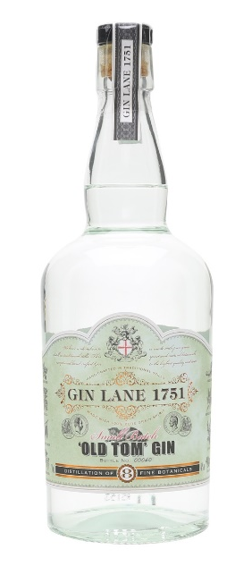
Invasions
Until 1066 Britain was invaded regularly
Romans
Saxons
Vikings
They would bring their favourite foods and ways of cooking
After that time we were invaded by fashions and tastes at court:
Forks
Gin
Notes:
The Romans introduced rabbits, along with many other things, for food.
Although distilling had been known from the 13th century – Gin only really started to be drunk in large quantities when William III, introduced Dutch distilling techniques into the country toward the end of the 17th Century.
The fork started to be used earlier in the 17th Century – before this it was seen as unmanly and an affectation.

Slide 50
Who brought it to Britain?
Who brought this to the British Isles?
Romans
Vikings
Normans
Portuguese
Dutch

Slide 51
Who brought it to Britain?
Who brought this to the British Isles?
Romans
Vikings
Normans
Portuguese
Dutch
Notes:
As well as pheasants, the Romans brought a variety of exotic foods to Britain, wine, rabbits, pheasants, and hare.
They brought vegetables such as cabbage, leeks, onions and turnips, fruit like cherries and also walnuts.
The Romans’ also brought herbs and flavourings such as garlic, pepper, basil and thyme. Their influence made food healthier and more flavourful!

Slide 52
Who brought it to Britain?
Who brought this to the British Isles?
Romans
Vikings
Normans
Portuguese
Dutch

Slide 53
Who brought it to Britain?
Who brought this to the British Isles?
Romans
Vikings
Normans
Portuguese
Dutch
Notes:
Well at they gave us the word. When it was first brought to the this country it was made out of Quince and was a favourite foodstuff of Anne Boleyn.
The first recipes using Citrus Fruit did not appear until 1714 – Mary Kettilby
James Robertson created Golden Shred marmalade in 1864

Slide 54
Who brought it to Britain?
Who brought this to the British Isles?
Romans
Vikings
Normans
Portuguese
Dutch

Slide 55
Who brought it to Britain?
Who brought this to the British Isles?
Romans
Vikings
Normans
Portuguese
Dutch
Notes:
As the Medieval era progressed the foods got more richer and more diverse. Knights and soldiers returning from the Crusades also brought back herbs such as parsley, basil and rosemary.
The first pears to come to England were presented to Henry III by the Sheriffs of the City of London.
That said, the food the rich ate at their feasts, dramatically differed from the poor, who ate a very simple diet.

Slide 56
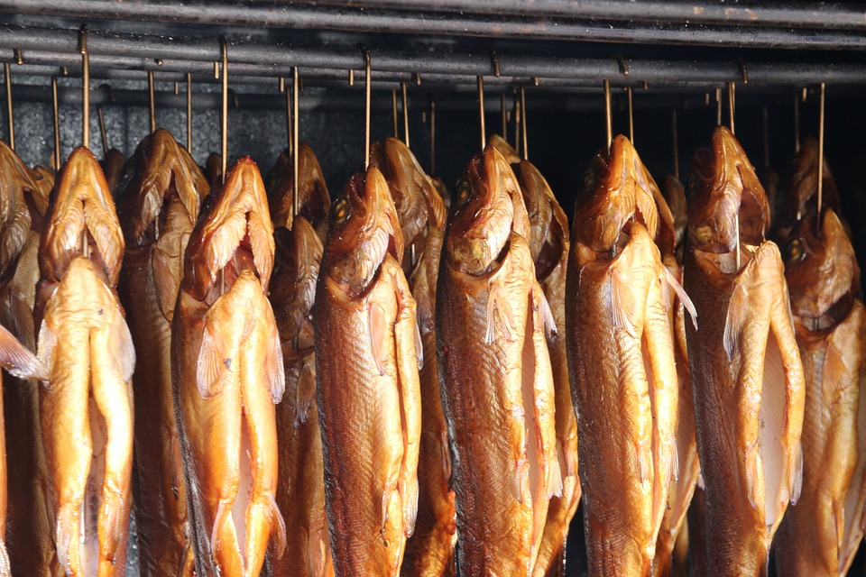
Who brought it to Britain?
Who brought this to the British Isles?
Romans
Vikings
Normans
Portuguese
Dutch
Notes:
Well at they gave us the word. When it was first brought to the this country it was made out of Quince and was a favourite foodstuff of Anne Boleyn.
The first recipes using Citrus Fruit did not appear until 1714 – Mary Kettilby
James Robertson created Golden Shred marmalade in 1864

Slide 57
Who brought it to Britain?
Who brought this to the British Isles?
Romans
Vikings
Normans
Portuguese
Dutch
Notes:
Vikings known to the English and Scottish as the Danes brought us the techniques for smoking and drying fish.
Today their culinary influence can still be felt in Scotland and some parts of northern England.
“Collops” is an old Scandinavian word for pieces or slices of meat, and a dish of Collops is traditionally served on Burns Night (25th January) in Scotland.

Slide 58
Who brought it to Britain?
Who brought this to the British Isles?
Romans
Vikings
Normans
Portuguese
Dutch
Notes:
As the Medieval era progressed the foods got more richer and more diverse. Knights and soldiers returning from the Crusades also brought back herbs such as parsley, basil and rosemary.
The first pears to come to England were presented to Henry III by the Sheriffs of the City of London.
That said, the food the rich ate at their feasts, dramatically differed from the poor, who ate a very simple diet.

Slide 59
Who brought it to Britain?
Who brought this to the British Isles?
Romans
Vikings
Normans
Portuguese
Dutch
Notes:
Developed by the Dutch in what used to be the Southern Netherlands and is now Belgium.
Earlier versions may have come across with the Romans, but the type we know now is definitely Dutch and along with Gin would have been popularised during his reign in the late 17th Century.

Slide 60
The British Empire
Began to take shape in the early 17th century
At it’s height in 1922 it ruled over about 458 million people
One quarter of the population of the world
Covered 33,700,000 km2
Almost a quarter of the Earth's total land area
Notes:
In the 19th Century one third of all shipping flew under the British flag

Slide 61
Empire and Colonialism
It started as a trading empire
Spices
Tea
Sugar
British often wanted to remain separate - aloof
They had food shipped from home
Marmalade
Dundee Cake
It took time for foreign food to become acceptable at home
Notes:
Initially the food that was imported were dry goods that could be stored and prepared (ground) in the UK. Because of distance they were very expensive.
Although the British had an empire, food either didn’t travel because there was no way to preserve it. Or there was no one to cook foreign food to an acceptable standard in the UK. Often foreign food items would be difficult to obtain and too expense for ordinary people for ordinary people to afford.
To preserve a distance between themselves and the people they ruled over the British would import stuff from home. The Keiller’s produced marmalade and jams – they would later go on to produce Dundee Cakes in tins, which would be shipped throughout the empire.

Slide 62
War
World War 1
Many recruits malnourished
Very poor personal hygiene
Liable to become ill easily
Army offered three regular meals a day
Free health care
The world was introduced “Bully Beef” = Corned Beef
Notes:
World War One – Many of the big houses with many, male servants, were required to surrender them for the war effort. Domestic service was not a protected area of work. When the war was over many people, but especially women; having had better paid work in factories, refused to return to badly paid domestic services. The vast variety of servants for niche areas of work within a home had to be severely reduced.
This meant that many people had to learn to cook their own food for the first time.

Slide 63
War
World War 2
Rationing until 4th July 1954
The concept of balanced diets
People did not go hungry
Limited food “sacrificed taste and stifled creativity”
Although the Black Market for illicit food items thrived
Britain got a well deserved reputation for terrible cuisine

Slide 64
Immigration
Immigrants built on the British culinary tradition
Fusing foreign flavours to spice up the traditional cuisine
Notes:
Culture refers to the ideas, behaviours, attitudes, and traditions that exist within a large group of people. These ideas, behaviours, traditions, etc. are passed down from one generation to the next and are often resistant to change. Different cultures have different ideas and attitudes regarding food. The general population in the UK tends to eat meat, fish, shellfish, vegetables and fruits, but some groups have the belief that eating certain foods is wrong. For example, to Hindus the cow is a sacred animal and so beef, to them, is not a food. Jews have religious laws forbidding them to eat pork and shellfish, so these are also not viewed as food. These examples illustrate how culture influences food preference. Furthermore, there are cultural differences in the way that people eat, which again influences food preference. There can also be changes within a culture over time and in societies like the US and the UK, there has been a move towards ‘grazing’ rather than sitting down and eating meals and also an increased preference for convenience foods and takeaway meals.

Slide 65
Immigration
Brought a wider range of flavours
Different styles of cooking
Cheaper foods to eat:
at home
or out
Home delivery
A willingness to stay open later – after pub closing
Notes:
What classic British dishes have been created or inspired by immigrants?
Participants may say:
Chicken Tikka Masala (originally Butter Chicken in India)
Chow Mein
Pizza
Fish and Chips (The first Chip Shop opened by Jewish Immigrants in 1863)
Kebabs and Chili sauce
Not all migration has provided food – no Irish restaurants
Culture refers to the ideas, behaviours, attitudes, and traditions that exist within a large group of people. These ideas, behaviours, traditions, etc. are passed down from one generation to the next and are often resistant to change. Different cultures have different ideas and attitudes regarding food. The general population in the UK tends to eat meat, fish, shellfish, vegetables and fruits, but some groups have the belief that eating certain foods is wrong. For example, to Hindus the cow is a sacred animal and so beef, to them, is not a food. Jews have religious laws forbidding them to eat pork and shellfish, so these are also not viewed as food. These examples illustrate how culture influences food preference. Furthermore, there are cultural differences in the way that people eat, which again influences food preference. There can also be changes within a culture over time and in societies like the US and the UK, there has been a move towards ‘grazing’ rather than sitting down and eating meals and also an increased preference for convenience foods and takeaway meals.

Slide 66
Holidays
Cheaper travel
More disposable income
Full employment gave the opportunity to have more holidays
Exposed to new foods and ways of eating
Being able to afford and try local wines
Wanting to experience these at home
Notes:
Rather than waiting for food experiences to come to us the British have gone exploring and found even more tastes to enjoy.

Slide 67
Holidays
This has left a ready market of Gap Year returnees for people setting up Thai Restaurants
Wine – once the province of the very rich has been democratised and is available to all
Notes:
Ask people if they can think of other cuisine than Thai.

Slide 68
TV Chefs
How many TV Chefs can you name?
How many Cakes/Meals have you have seen on TV?
How many have you tried to recreate?
Notes:
Ask people how many celebrity chefs they can think of.
The photo is of Fanny Craddock

Slide 69
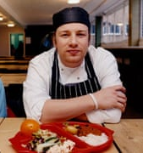
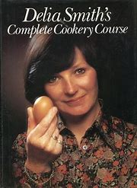
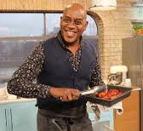
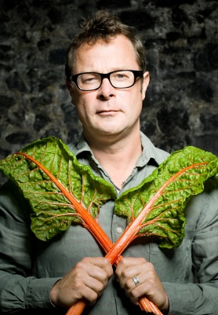
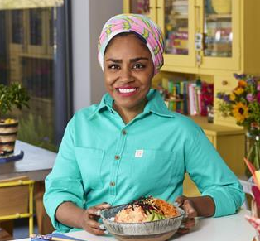
TV Chefs
It is arguable that TV Chefs are filling a void
Domestic Science (Cookery Lessons) no longer taught at schools
Parents increasingly work leaving less time for complicated cooking
People take comfort in watching food being produced
Don’t necessarily wish to cook the meals themselves
Notes:
Delia’s popularity also translated commercially: products featured on her shows, such as frozen mash, and utensils, such as an omelette pan, became overnight mega-sellers. And unlike the mildly terrifying Fanny Cradock before her, Delia was no food snob. Her debut bestseller How to Cheat at Cooking (1971 and reproduced in 2008) featured time-saving recipes and quick cookery tips – a forward-thinking idea for our own fast-paced times.
Delia- the basics quick, easy to do
Jamie School Dinners
Hugh Fearnley Whittingstall - fish campaign
Nigella – fun with food – indulgence
Ainsley Harriot – cooking games shows

Slide 70
A working Break
This is a time to allow people to taste some of the food items you have brought with you.
Back in 15 minutes or so!

Slide 71
Time line Exercise

Slide 72
Timeline Exercise
Place your food on the timeline at the point you think it was first introduced to the UK
Check to see where other people have placed their food items
Move yours and replace it on a different time if you want

Slide 73
Pasta

Slide 74
Pasta
1400
In British cookery since the Middle Ages
Early forms of lasagne and cheese macaroni cheese found in a book of recipes
Dated from about 1400
Notes:
These dishes were mainly served in more affluent households because they took so long to prepare. It wasn’t until the 1970’s did pasta get more mainstream and accessible for the average family.

Slide 75
Pineapples

Slide 76
Pineapples
1493
The first to be grown in the UK was in 1723

Slide 77
Coffee

Slide 78
Coffee
1580
Oxford has a great history of coffee drinking.
In 1637 Turk introduced the drink to Oxford
Popular among students and academic staff
The Queen Lane Coffee House in Oxford opened in 1654 and still welcomes customers

Slide 79
Bananas

Slide 80
Bananas
1633 first sold in the UK
Fyffe record bringing their first shipment in 1888
Expensive fruit enjoyed by the rich
Over 5 million bananas are eaten in the UK annually

Slide 81
Broccoli

Slide 82
Broccoli
Mid18th Century (1750)
Known as “Italian Asparagus”
Readily available in supermarkets in the UK from the 1970’s
Notes:
The Romans bought broccoli to Britain, it was a popular vegetable for them as it is easy and fast growing.
When first re-introduced in England in the mid-18th century, broccoli was referred to as "Italian asparagus." It was available in supermarkets from the 1970’s and was only available in season.

Slide 83
Curry

Slide 84
Curry
1747
Via the East India Company
Curry is a British term
First Indian Restaurant opened in 1809
Curry houses popular in the 1940’s
A resurgence in the 1970’s

Slide 85
Afternoon Tea

Slide 86
Afternoon Tea
1840’s
Tea was fashionable from the mid-17th Century, but confined to the aristocracy by it very high price
The Duchess of Bedford started the trend in 1840
Afternoon Tea became an opportunity for women to meet
Also an opportunity for them to ‘showcase’ their daughters
Notes:
Tea became cheaper once it started being produced in India in the 19th Century. It’s low cost enabled may people to partake. The British made the drink their own by adding milk and sugar, much to the disgust of the rest of the world!

Slide 87
Bagels

Slide 88
Bagels
1850’s
The first bagel shop in Spitafields, London in 1855
The word bagel comes from the Yiddish/German meaning ‘ring’ or ‘bracelet’
Brick Lane has two original Bagel bakeries owned by the same family

Slide 89
Fish and Chips

Slide 90
Fish and Chips
1863
First Fish & Chip shop in the North of England in 1863
In London chips and fish fried in the “Jewish Fashion” was being sold in 1860
In 1865 Henry Mayhew in his survey of the “London Poor” has as many as 300 fried fish sellers
The new railways allowed white fish to be gotten to the big cities
Notes:
Fish and chips were cheap. They catered to people in poor areas who had no access to a place to prepare food. They were ideal for households where all the adults and often the children, worked long hours with little or no time to cook.

Slide 91
Chilli

Slide 92
Chilli
1900
Discovered by Christopher Columbus
Only became popular in the UK with the popularity of curry
Nowadays vast range of chillies available
Often grown in the UK

Slide 93
Chow Mein

Slide 94
Chow Mein
1938
First Chinese food in the UK around the docks in London and Liverpool where Chinese sailors would gather to eat.
First Chinese restaurant opened in 1908 in London
In 1938 Chow Mein popular with students at Cambridge as it was cheap

Slide 95
Burgers

Slide 96
Burgers
1954
Wimpy opened its first branch 1954 on London’s Coventry Street
McDonalds opened the first restaurant in 1974 in Woolwich
Burger King opened in 1976 in the Haymarket

Slide 97
The Formals
Catering for the world in the UK

Slide 98
In your small groups consider each of the situations listed in your work book
What food and drinks would you suggest?
You are allowed to use your phones to get further information for some scenarios – check with the trainer before you cheat!

Slide 99
Action planning

Slide 100
Action planning
Take some time to reflect on what has been discussed in this course. Considering what has been discussed, how might this alter your practice or approach?
In groups on twos or threes, discuss what you might change or consider going forward
What might your first step be?

Slide 101
Any final questions?

Slide 102
THANK YOU Dipti Morjaria
training@challcon.com
020 7272 3400
Scan the QR Code with your iPhone, Android, Blackberry or Windows Phone 7 phone. Download a QR code reader App from your favourite store.

